Slide 1
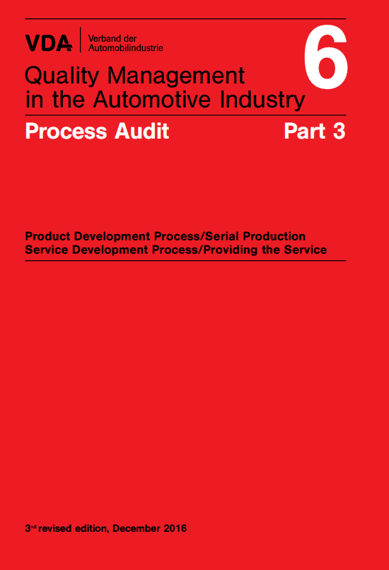
LE80-019
VDA 6.3 – Questionnaire P6
Questionnaire
Chapter 7
Carrying out process audits systematically and effectively
Content:
Questionnaire Process element P6 Process analysis Production

Slide 2
LE80-020
VDA 6.3 – Questionnaire P6
Process element P6 – Process analysis / Production
Receive order
Issue contract
SOP
Organisation
Offer processing (contract review)
Product/ process definition
Preselection of suppliers: potential analysis
Product/ process development
Serial production
Customer service (after sales)
Allocation of questions
P2
P3
P4
P5
P6
What is ensured?
P6.1: What goes into the process – Process input
P6.2: Are all production processes controlled – Process management
P6.3: What functions support the process – Personnel resources
P6.4: What means are used to implement the process – Material resources
P6.5: How effective is the process being carried out – Effectiveness, efficiency, …
P6.6: What should the process produce – Process result (output)

Slide 3
LE80-021
VDA 6.3 – Questionnaire P6
Layout of questions using the turtle approach
6.4
What means are used to implement the process?
Material Resources
Equipment, facilities
6.3
What functions, areas, personnel support the process?
Personnel Resources
Training, knowledge, skills, authorities
6.1
6.6
P6
Process analysis/ Production
Input
Output
I
P4.x
O
I
P6.x
O
What goes into the process?
What should be the result of the process?
Interface
Interface
6.2
How dies the process run?
Process Operation
Implementation rules: instructions, procedures, methods
6.5
How effective is the process being carried out?
Effectiveness
Performance indicators, targets

Slide 4
LE80-023
VDA 6.3 – Questionnaire P6
Sub-element P6.1 – Process input
What means are used to implement the process?
Material Resources
Equipment, facilities
P6.1 – What is ensured?
A transfer of the project from development to serial production has been carried out
The correct product (incoming material, part, component etc.) must be provided to the agreed quality, in the correct quantity and the correct packing, with the correct documentation, at the agreed time and at the agreed place
Releases and approvals for incoming goods are available and identifiable
Process or product changes are documented and communicated
6.4
6.3
Welche Funktionen/Bereiche/ Personen unterstützen den Prozess?
Prozessunterstützung
Schulung, Wissen, Fähigkeit, Befugnisse
6.1
6.6
P6
Processalyse/ Produktion
Input
Output
I
P4.x
O
I
P6.x
O
What goes into the process?
Interface
Was soll das Ergebnis des Prozesses sein?
Schnittstelle
6.2
How dies the process run?
Process Operation
Implementation rules: instructions, procedures, methods
6.5
Wie wirkungsvoll wird der Prozess durchgeführt?
Wirkungsgrad
Leistungsindikatoren, Kennzahlen

Slide 5
6.1.1* Has the project been handed over from development to series production and is a reliable start guaranteed?
Minimum requirements relevant for assessment
The project handover to series production has been documented according to the specified criteria. The responsibilities for the entire handover process are specified and acknowledged. Unresolved issues are followed up on, and the necessary measures are implemented on schedule. A complete production process and product release (PPA) including the documentation required is available before the first production shipment. Measures to secure the production start-up have been implemented on the basis of a risk analysis. Tools, transport and series packaging, inspection and measuring equipment are available in the necessary quantities. Analysis options for failure analysis are available. The product software corresponds to the latest release versions.
Examples for implementation
Handover reports
defined measures and implementation schedule
Production release report
Releases for all production line components and tools
PPA documents, including customer release and reference parts regarding the PPA procedure
Special releases
Released software versions
Examples for securing the production start-up: Higher inspection frequency, additional inspections, Resident Engineer
Safe-launch concept

Slide 6
6.1.2 Are the necessary quantities/production batch sizes of the materials available at the agreed-upon time and at the specified location?
Minimum requirements relevant for assessment
The material is of the agreed quality and is provided in the correct quantity and the correct packaging, with the correct documentation, at the agreed time and at the agreed place. Parts/components are available at defined storage areas/work-stations. At the workplace, products and materials are provided as needed, taking into account the order quantity/lot size in accordance with the logistics concept. The use of residual quantities and their traceability is clearly defined. Regulations for reintroducing parts from outsourced processes (including sorting service) are available
Examples for implementation
Material includes, for example: Software, packaging, load carriers, parts and components, raw material, semi-finished products, series packaging for delivery to the customer, operating, auxiliary and process materials
Suitable means of transport
Defined storage locations and stock levels
KANBAN, Just in time/Just in sequence, FIFO/FEFO
Revision/change status of materials and software
Special requirements regarding components and containers (e.g. ESD protection, humidity, temperature, residue)

Slide 7
6.1.3 Are materials stored appropriately and are the means of transport/packaging facilities suitable for the specific properties of the materials?
Minimum requirements relevant for assessment
Packaging requirements are consistently taken into account/fulfilled. During manufacturing and in-house transport and also when being transported to and from service providers, suitable transport units are used to protect the products from damage and contamination. Storage areas/work-stations/containers are appropriate for the tidiness and cleanliness required for the material. Cleaning cycles are defined and monitored. The supply of materials at the work-station/on the assembly line allows for safe handling. Specified storage times and use-by dates for materials are monitored by means of appropriate methods. Operating and auxiliary materials for production lines and machines that have a direct effect on the product/product quality are monitored accordingly. Materials, operating and auxiliary materials are protected against environmental and climatic influences
Examples for implementation
Stock quantities
Storage conditions
Released special and standard transport containers
Protection against damage to the material
5S
No over-filling (storage areas and containers)
Maximum and minimum storage times, specified interim storage times, FIFO/FEFO)

Slide 8
6.1.4 Are the necessary identifications/records/releases available and allocated appropriately to the materials?
Minimum requirements relevant for assessment
The release status of materials is clearly identifiable. The release identification on bundles/batches/load carriers/parts is defined. It is ensured that only released materials/parts are forwarded to production/the next production stage and used. Traceability from the sub-supplier to the customer is guaranteed according to a defined traceability concept. Customer specifications as well as statutory and regulatory requirements regarding labeling are taken into account
Examples for implementation
Customer specifications regarding labeling and traceability
Labeling of released parts/materials (stickers, labels, issue slips, VDA label, Data Matrix Code (DMC) etc.)
Records of approvals
Traceability system
Documentation of special releases (number, duration, type of identification, etc.)
Stock management systems

Slide 9
6.1.5* Are changes to the product or production process during series production tracked and documented?
Minimum requirements relevant for assessment
Examples for implementation
Changes to the product and the production process are implemented in accordance with the change management described. Changes to the product and production process are agreed upon with the customer, approved and released (including software changes) in accordance with customer requirements. A PPA is carried out. The history of change statuses is fully traceable. The correct, released version of the material/software is used. After changes have been made, it is checked whether the risk analyses need to be updated
Examples for implementation
Trigger matrix in accordance with VDA Volume 2 or customer specifications
Documented release of a change
Multi-disciplinary evaluation prior to changes
Change history/parts history (also for software)
Design and process FMEA
Operation management in case of changes
Pre-production
Unique software identifier, software integrity (build number, hash key)

Slide 10
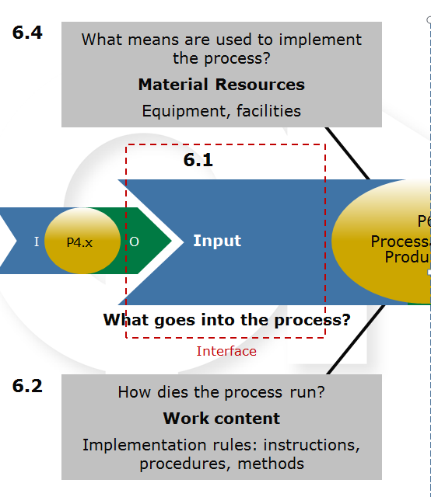
LE80-035
VDA 6.3 – Questionnaire P6
Sub-element P6.2 – Process Management
P6.2 – what is ensured?
Production processed are based on a control plan, regulated and released
The repeat release of production processes is regulated
Special characteristics are managed
Non-approved and/or defective parts are managed
The flow of materials and parts secured against mixing/wrong items
To participant 18-22 Oct 2021
Process Operation

Slide 11
6.2.1 Are the requirements in the production control plan as well as the production and inspection documents complete and are they effectively implemented?
Minimum requirements relevant for assessment
The production and inspection documents are complete and are based on the production control plan. The data relating to released machinery/tools/aids is noted in the production control plan and/or the production and inspection documents. The documents are accessible close to the work-station. Required measures for process disturbances are described in the production control plan and are implemented and documented. Process parameters influencing product properties/quality are fully stated. Tolerances are stated for process parameters and inspection characteristics. The control limits in process control charts are defined, identifiable and plausible. Deviations and initiated measures regarding process requirements and inspection characteristics are documented. Conditions governing rework are specified, assessed as part of the risk analysis and secured within the process (parts identification; repeat inspection etc.).
Examples for implementation
Inspection characteristics, inspection equipment, inspection methods, inspection frequencies, inspection cycles and requalification
Data regarding machines/tools/aids (identification numbers), process parameters and tolerances (pressure, temperatures, times, speeds etc.)
Work instructions (including rework)
Inspection instruction

Slide 12
6.2.2 Does a release of production processes take place?
Minimum requirements relevant for assessment
A process-specific release inspection for first piece/last piece and re-release was carried out and documented. A release is necessary for the product and the production process and is carried out and documented by authorized employees using acceptance criteria. Deviations and initiated measures are documented. At the time of release, the necessary reference and boundary samples are available. Criteria for triggering a re-release are defined, e.g. after an interruption of production. If production is continued after the collection of inspection parts, these products are accessible until the inspection parts are
Examples for implementation
Release of a batch, including re-release
First piece/last piece and re-release
Tooling diagrams/reference parts/setup parts (e.g. failure test pieces, OK/NOK samples)
Possible triggering criteria for a re-release:
- Production interruption (e.g. night time in two-shift operations, tool changes, material/ batch/product change)
- Repair, tool change
- Changed setting data
Released rework

Slide 13
6.2.3* Are special characteristics controlled in production?
Minimum requirements relevant for assessment
Special characteristics specified by the customer and the organization as well as defined process parameters are marked in the production control plan, are systematically monitored and documented. Records of deviations and corrective actions are maintained. Deviations affecting the properties of the product are approved by the customer. Records regarding special characteristics are available. The duration and type of archiving of these records are specified and meet the customer requirements.
Examples for implementation
Drawings
Labeling indicating the customer-specific special characteristics, e.g.: D/TLD, DS, DZ, R, S, F
Process FMEA
Production control plan
SPC evaluations
Quality control charts
Proofs of capability
Proofs of inspection process capability
Inspection results
Process parameter records

Slide 14
6.2.4* Are suspect and nonconforming products controlled?
Minimum requirements relevant for assessment
Suspect products and nonconforming products are separated, labeled, recorded and safely removed from the production process. These products are either directly marked or marked on their container. Authorized personnel decide on the further use of suspect products. The scope (including inspection and release) of permitted rework is described in work instructions. Quarantine stores and quarantine areas are clearly labeled. Accidental or unauthorized use of blocked products is excluded
Examples for implementation
Labeling indicating the product status
defined scrap/rework-stations in production
Quarantine stores and quarantine areas , clearance areas
Documentation regarding rejects, rework and repair
Authorizations

Slide 15
6.2.5 Is the flow of materials secured against mixing/wrong items?
Minimum requirements relevant for assessment
A mix-up of materials or the use of wrong materials, software or components is ruled out. Appropriate measures are taken to ensure that any mix-ups of parts or any use of wrong parts/incorrect installation of parts is detected early on.The use status of the products is clearly evident from the labeling. The use of separated parts, reworked parts and reusable products is clearly defined. Traceability is ensured. Setting masters, setup and reference parts are labeled and protected against accidental use
Examples for implementation
Process FMEA
Poka-Yoke actions
Checks and inspections in production facilities
Traceability of batches
FIFO/FEFO
KANBAN
Removal of invalid labeling
Value stream analysis
Sorting service
Unique software identifier, software integrity (build number, hash key)

Slide 16
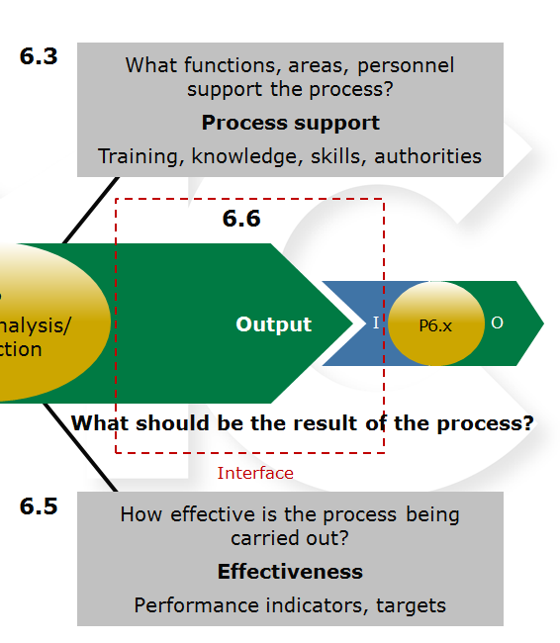
LE80-047
VDA 6.3 – Questionnaire P6
Sub-element P6.3 - Personnel resources
P6.3 – what is ensured?
The employees able to fulfil their given tasks
Employees know the responsibilities and authorities in the monitoring of the product and process quality
The necessary personnel resources are available
Personnel Resources

Slide 17
6.3.1 Are the employees able to fulfill their given tasks?
Minimum requirements relevant for assessment
For each task/job, the corresponding requirements profile has been specified. The employees’ qualification is in line with the requirements profile. If this is not the case, a qualification scheme are put in place. Instructions, trainings and inductions provided to the employees as well as proofs of qualification are documented. Proof of special qualifications required for the relevant job is available. In case of changes to processes, trainings/instructions are provided and documented.The requirements also apply to temporary employees.
Examples for implementation
Evidence of qualifications
Training plan
Initial training plan, including evidence
On-the-job training
Qualification matrix
Knowledge about the product and failures that have occurred
Handling of measuring equipment
Interpretation of control charts
Training/instructions regarding occupational safety
Training in special characteristics
Suitable evidence of qualification (e.g. welding certificate, vision test results, hearing test results)

Slide 18
6.3.2 Do the employees know their responsibilities and authorizations regarding the monitoring of product and process quality?
The employees’ responsibilities, duties and authorities are described and implemented. The employees know the consequences of incorrect execution of work. The tasks/functions of the product are known. It is also known what happens when they are no longer guaranteed. Employees receive regular information on the current quality performance achieved and are informed about customer complaints. The requirements also apply to temporary employees
.
Examples for implementation
Work/inspection instructions
Job descriptions
Setup release, first piece inspection, last piece inspection
Authority to stop and start the process
Escalation protocol
Product training
Product safety/product liability training

Slide 19
6.3.3 Are the necessary personnel resources available?
Minimum requirements relevant for assessment
There is a staff schedule for all shifts. The staff schedule takes into account the required number of qualified employees. Rules exist for supporting areas that are not continually in use (e.g. laboratory, measurement room). Fluctuations in customer orders and workforce absences (e.g. illness, holidays, training) are taken into account in the staff schedule. The requirements also apply to temporary employees
.
Examples for implementation
Shift plan
Evidence of qualifications
Qualification matrix
Documented absence management rules
Staff schedule
Mentors

Slide 20
LE80-055
VDA 6.3 – Questionnaire P6
Sub-element P6.4 - Material resources
P6.4 – What is ensured?
The product-specific requirements from the customer be met with the manufacturing equipment
The maintenance of the manufacturing equipment and tools is controlled
Test and measuring equipment/ facilities used are suitable, effective and monitored
Work and inspection stations are appropriate for the products and the work carried out, in order to prevent or eliminate contamination, damage, mixing-up of parts
Tools, equipment and test equipment are stored properly
6.3
Welche Funktionen/Bereiche/ Personen unterstützen den Prozess?
Prozessunterstützung
Schulung, Wissen, Fähigkeit, Befugnisse
6.6
I
O
I
P6.x
O
Schnittstelle
6.5
Wie wirkungsvoll wird der Prozess durchgeführt?
Wirkungsgrad
Leistungsindikatoren, Kennzahlen
Process Operation

Slide 21
6.4.1* Is the manufacturing equipment suitable to meet the customer’s product-specific requirements?
Minimum requirements relevant for assessment
It is demonstrated that the processes are implemented in accordance with the customer requirements using the existing production facilities, and that the resulting products meet the customer specifications. The production facilities, machines and production lines are able to comply with the specified tolerances for the respective product and process characteristics. Parameters and software that influence the process are protected against unauthorized access. Process capability must be determined for selected product and process characteristics, and proof of capability must be provided. The process capability must meet internal specifications as well as customer specifications. The minimum requirement for process capability is Cpk ≥ 1.33. In case of characteristics where a certain capability is required but proof of capability cannot be obtained, a 100% inspection is required.
Examples for implementation
Proof of machine/process capability
Monitoring of key process parameters (e.g. pressure, time, temperature)
Capability of replacement tools
Feed and removal systems
Reproducibility of gages, fixtures etc.
Cleanliness requirements
Configuration management, ensuring provision of software in accordance with the unique identifier, software integrity (build number, hash key)

Slide 22
6.4.2 Is the maintenance of the manufacturing equipment and tools controlled?
Minimum requirements relevant for assessment
Preventive and/or predictive maintenance activities (maintenance, inspection and repair) are defined and implemented for all machines, production lines, equipment and tools based on the risk. Scheduled and unscheduled maintenance activities that have been carried out are documented and analyzed with regard to potential improvement measures. Resources needed to carry out necessary maintenance activities are available. A process for the analysis and optimization of down-time, machine utilization and tool life is implemented effectively. The availability of replacement parts is ensured. Tools undergo tool management which includes the following:Tool history including all changes and tool life
- Operational status
Labeling of tools
These requirements also apply to external service providers
Examples for implementation
Production-related logistical equipment, such as forklift trucks
Maintenance and servicing schedules
TPM Total Productive Maintenance
Key processes and bottleneck machines
Technical documentation provided by the manufacturer
preventative tool exchange programs for units subject to increased wear
Tool operation sheet
Operational status of tools, e.g. operational, not operational
Labeling of tools, e.g. property of the customer, tool no., index

Slide 23
6.4.3* Can the conformity of quality requirements be effectively monitored by the use of measurement and inspection equipment?
Minimum requirements relevant for assessment
The measuring and inspection systems used are suitable for the intended purpose and handling in production. They are included in the production control plan. Proofs of capability are available for the measuring and inspection systems used. All systems and devices used in the inspection process are labeled. The validity status is monitored. A process for monitoring the ongoing capability of measuring and inspection systems is established and implemented. In case of deviations, an assessment of potential risks in relation to the process, the product and the customer is carried out. Measures have been defined and are implemented effectively. Measuring systems and corresponding standards as well as reference materials that have an influence on the measurement result are monitored in the same way.
Examples for implementation
Measuring system analysis
Measurement and inspection process capability
Replacement measuring device
Integrity check embedded software
Calibration status (inspection sticker, barcode, engraving, etc.)
Validation of the measurement and inspection software
Reference parts and materials
Monitoring test equipment

Slide 24
6.4.4 Do the work and inspection stations fulfill the requirements?
Minimum requirements relevant for assessment
Workplace and ambient conditions are appropriate for the products and the work content, in order to prevent or eliminate contamination, damage, mix-ups of parts and the use of wrong parts. This also applies to rework, sorting and inspection stations that have been permanently or temporarily set up. The layout of the work station is adapted to the work to be carried out
.
Examples for implementation
Cleanliness and tidiness, 5S
Lighting
Noise pollution
Climate control
Clean rooms
ESD
Layout of the work station
Surroundings/handling of parts at the work station
Occupational health and safety

Slide 25
6.4.5 Are tools, devices and inspection equipment stored properly?
Minimum requirements relevant for assessment
All tools, devices and inspection equipment are stored properly. It is ensured that the equipment is stored in such a way as to be protected against damage and environmental effects. Cleanliness and tidiness are ensured. The issue and use of this equipment is controlled and documented.
.
Examples for implementation
Protection against: collision, pollution, environmental influence
5S Method
Defined storage location, e.g. markings on the floor
Transparent warehouse management

Slide 26
LE80-067
VDA 6.3 – Questionnaire P6
Sub-element P6.5 – Effectiveness, efficiency, waste avoidance
P6.5 – What is ensured?
Targets are set for the manufacturing process
Quality and process data is collected in a way that allows analysis
In case of deviations the causes are analysed and corrective actions checked for effectiveness
Products and processes are audited regularly
Personnel Resources

Slide 27
6.5.1 Have targets been set for the production process?
Minimum requirements relevant for assessment
Process-specific targets regarding effectiveness and efficiency are defined, monitored and communicated. Customer requirements are taken into account when setting targets. A regular comparison between specified targets and actual results is made and documented
.
Examples for implementation
Key production figures, e.g. quantities produced, quality metrics, throughput times, defect costs, process effectiveness figures, production line and machine availability
First time through quality, First pass yield
Reduction of waste (e.g. rejects and rework, energy and process materials)

Slide 28
6.5.2 Is quality and production process data collected in a way that allows for analysis?
Minimum requirements relevant for assessment
The quality and process parameters required to demonstrate product conformity (target values) are defined and documented. The actual data is analyzed and appropriate improvement measures are initiated. Special incidents are documented. The recorded data can be allocated to a product and process, the data is available, legible, accessible and archived as specified. Traceability requirements are met. The potential for improvement is continuously determined based on findings relating to quality, costs, and services.
Examples for implementation
Control charts
Check sheet
Types of errors/error frequencies
Rejects/rework
Process data sheet with parameter changes
Shift/machine log
Cycle times, throughput times
Fault message (e.g. production line standstill, power outage, program error message)
Output/availability
Blocking message/sorting actions
Traceability

Slide 29
6.5.3* If product or production process requirements are not met, are the causes analyzed and the corrective actions checked for effectiveness?
Minimum requirements relevant for assessment
If product and production process requirements are not met, containment actions are taken to fulfill the requirements, until it has been proven that the corrective actions have been effective. The employees are familiar with these containment actions. Suitable methods are implemented to analyze the causes. Repeat failures are recorded. A more detailed analysis of the causes must be carried out accordingly. Corrective actions are derived from the cause analysis, their implementation is monitored and the effectiveness is verified. The production control plan and the risk analysis are updated on an event-oriented basis. Deviations that affect the properties of the delivered product are communicated to the customer
Examples for implementation
8D method
Cause and effects diagram
Taguchi, Shainin
5 Why method
Process capability analysis
Design and process FMEA
Waivers/special releases
Additional dimensional, material, functional and endurance testing

Slide 30
6.5.4 Are processes and products audited regularly?
Minimum requirements relevant for assessment
The audit program for process and product audits is based on customer requirements as well as specific risks and is implemented. The process and product audits carried out are suitable to identify specific risks and weaknesses. If deviations are detected during an audit, the causes are analyzed. Corrective actions are derived, their implementation is monitored and the effectiveness is verified. Deviations that affect products which have already been delivered are communicated to the customer..
Examples for implementation
Specifications
Special characteristics
Audit program including scheduled and event-oriented audits
Frequency of audits
Audit results, audit reports, action plans
Auditor qualification
Scope of the audit, e.g.: P5, P6, P7
Labeling, packaging
Change status of individual parts and software

Slide 31
LE80-077
VDA 6.3 – Questionnaire P6
Sub-element P6.6 – Process result (Output)
P6.6 – What is ensured?
Quantities produced match the need and are systematically directed to the next process step
Products/components are stored and transported in an appropriate manner
Records and releases are documented and retained
Customer requirements are met at the delivery of the final product
Personnel Resources

Slide 32
6.6.1 Do the quantities/production batch sizes match needs and are they systematically directed to the next production process step?
Minimum requirements relevant for assessment
Products are forwarded to defined storage/holding points using suitable means of transport. The order quantity/batch size is taken into account, so that only the required quantity of products is moved to the stipulated storage/holding point. The use status of the product (OK part, rework, reject, etc.) is evident from the labeling (component, container etc.). The change status is clearly indicated. It is ensured that only OK parts move on to the next production process step. Rules are put in place for returning residual quantities, including the recording of the quantities as well as further processing.
Examples for implementation
KANBAN
FIFO/FEFO
JIT/JIS
Warehouse management
Production quantities tailored to the customer’s needs
Technical cleanliness

Slide 33
6.6.2 Are products stored in an appropriate manner and are the means of transport/packaging facilities suitable for the specific properties of the products?
Minimum requirements relevant for assessment
The products are protected from damage by suitable storage and packaging. Internal and customer-specific packaging instructions are known and are implemented. This also applies to released replacement packaging. The storage areas/containers meet the requirements with regard to cleanliness. Specified storage times are monitored. Products are protected against environmental and climatic influences during storage and shipment. The requirements apply to the handling during the production processes as well as during shipment
Examples for implementation
Protection from damage
ESD protection for electronic components
Technical cleanliness
Cleanliness and tidiness, 5S
No over-filling (storage areas and containers)
Monitoring of storage times/storage quantity (maximum/minimum storage times, specified interim storage times)
Specifications regarding the cleaning of packaging
Sufficient amount of packaging

Slide 34
6.6.3 Are the necessary records and releases retained?
Minimum requirements relevant for assessment
The release of the products as well as the relevant evidence is documented. Special releases/waivers are documented. The documentation covers the period and/or quantity of products involved. Internal specifications and customer specifications regarding the documentation of rework and repair are fulfilled. The traceability of products is ensured. Customer requirements with regard to archiving are fulfilled.
Examples for implementation
Customer specifications
Customer specifications for archiving time limits
Archiving requirements/regulations (e.g. EDP, paper, fire protection, legibility)
Parts history

Slide 35
6.6.4* Are the customer requirements met upon delivery of the product?
Minimum requirements relevant for assessment
The customer-specific requirements regarding the final product (delivery reliability, quality targets, quality performance etc.) are known. The fulfillment of these requirements is continuously monitored, assessed and documented. In case of deviations, the causes are analyzed, measures are defined and implemented and their effectiveness is ensured. Products are labeled, stored and shipped in accordance with the customer requirements. In case of special releases/waivers, products and packaging are labeled accordingly. Internal specifications as well as customer specifications regarding the labeling of reworked or repaired products are observed. The handling of supplied products is regulated. Customers should be informed of delivery stops which affect them, and the further procedure should be coordinated with them.
Examples for implementation
Quality agreements with the customer
Packaging specification
Target agreements
Shipping audit
Customer specifications regarding labeling (e.g.: VDA label)
Labeling in cases of special releases

